Slide 1
MACHINE LEARNING
Session – 7
Date – 04th June, 2022

Slide 2
MACHINE LEARNING

Slide 3
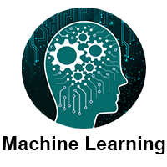
Overview
Machine Learning tutorial provides basic and advanced concepts of machine learning.
Machine learning is a growing technology which enables computers to learn automatically from past data. Machine learning uses various algorithms for building mathematical models and making predictions using historical data or information. Currently, it is being used for various tasks such as image recognition, speech recognition, email filtering, Facebook auto-tagging, recommender system, and many more.
This machine learning tutorial gives you an introduction to machine learning along with the wide range of machine learning techniques such as Supervised, Unsupervised, and Reinforcement learning. You will learn about regression and classification models, clustering methods, hidden Markov models, and various sequential models.

Slide 4
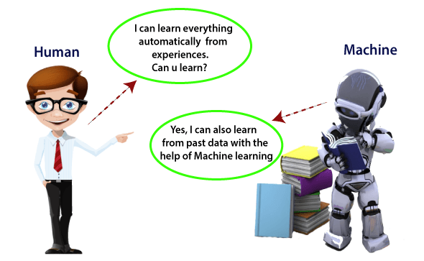
What is Machine Learning?
In the real world, we are surrounded by humans who can learn everything from their experiences with their learning capability, and we have computers or machines which work on our instructions. But can a machine also learn from experiences or past data like a human does? So here comes the role of Machine Learning.
Machine Learning is said as a subset of artificial intelligence that is mainly concerned with the development of algorithms which allow a computer to learn from the data and past experiences on their own. The term machine learning was first introduced by Arthur Samuel in 1959.
With the help of sample historical data, which is known as training data, machine learning algorithms build a mathematical model that helps in making predictions or decisions without being explicitly programmed. Machine learning brings computer science and statistics together for creating predictive models. Machine learning constructs or uses the algorithms that learn from historical data. The more we will provide the information, the higher will be the performance.
A machine has the ability to learn if it can improve its performance by gaining more data.

Slide 5
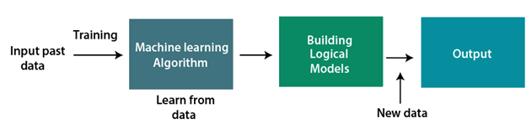
How does Machine Learning works?
A Machine Learning system learns from historical data, builds the prediction models, and whenever it receives new data, predicts the output for it. The accuracy of predicted output depends upon the amount of data, as the huge amount of data helps to build a better model which predicts the output more accurately.
Suppose we have a complex problem, where we need to perform some predictions, so instead of writing a code for it, we just need to feed the data to generic algorithms, and with the help of these algorithms, machine builds the logic as per the data and predict the output. Machine learning has changed our way of thinking about the problem. The below block diagram explains the working of Machine Learning algorithm:

Slide 6
Features of Machine Learning:
Machine learning uses data to detect various patterns in a given dataset.
It can learn from past data and improve automatically.
It is a data-driven technology.
Machine learning is much similar to data mining as it also deals with the huge amount of the data.

Slide 7
Need for Machine Learning
The need for machine learning is increasing day by day. The reason behind the need for machine learning is that it is capable of doing tasks that are too complex for a person to implement directly. As a human, we have some limitations as we cannot access the huge amount of data manually, so for this, we need some computer systems and here comes the machine learning to make things easy for us.
We can train machine learning algorithms by providing them the huge amount of data and let them explore the data, construct the models, and predict the required output automatically. The performance of the machine learning algorithm depends on the amount of data, and it can be determined by the cost function. With the help of machine learning, we can save both time and money.
The importance of machine learning can be easily understood by its uses cases, Currently, machine learning is used in self-driving cars, cyber fraud detection, face recognition, and friend suggestion by Facebook, etc. Various top companies such as Netflix and Amazon have build machine learning models that are using a vast amount of data to analyze the user interest and recommend product accordingly.
Following are some key points which show the importance of Machine Learning:
Rapid increment in the production of data
Solving complex problems, which are difficult for a human
Decision making in various sector including finance
Finding hidden patterns and extracting useful information from data.

Slide 8
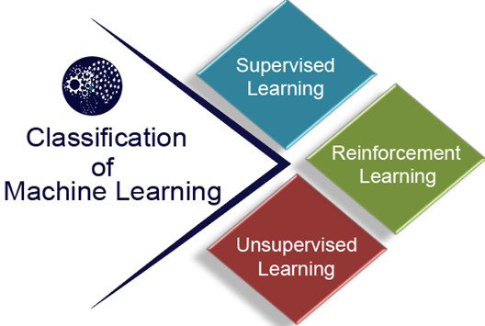
Classification of Machine Learning
At a broad level, machine learning can be classified into three types:
Supervised learning
Unsupervised learning
Reinforcement learning

Slide 9
Supervised Learning
Supervised learning is a type of machine learning method in which we provide sample labeled data to the machine learning system in order to train it, and on that basis, it predicts the output.
The system creates a model using labeled data to understand the datasets and learn about each data, once the training and processing are done then we test the model by providing a sample data to check whether it is predicting the exact output or not.
The goal of supervised learning is to map input data with the output data. The supervised learning is based on supervision, and it is the same as when a student learns things in the supervision of the teacher. The example of supervised learning is spam filtering.
Supervised learning can be grouped further in two categories of algorithms:
Classification
Regression

Slide 10
Unsupervised Learning
Unsupervised learning is a learning method in which a machine learns without any supervision.
The training is provided to the machine with the set of data that has not been labeled, classified, or categorized, and the algorithm needs to act on that data without any supervision. The goal of unsupervised learning is to restructure the input data into new features or a group of objects with similar patterns.
In unsupervised learning, we don't have a predetermined result. The machine tries to find useful insights from the huge amount of data. It can be further classifieds into two categories of algorithms:
Clustering
Association

Slide 11
Reinforcement Learning
Reinforcement learning is a feedback-based learning method, in which a learning agent gets a reward for each right action and gets a penalty for each wrong action. The agent learns automatically with these feedbacks and improves its performance. In reinforcement learning, the agent interacts with the environment and explores it. The goal of an agent is to get the most reward points, and hence, it improves its performance.
The robotic dog, which automatically learns the movement of his arms, is an example of Reinforcement learning.

Slide 12
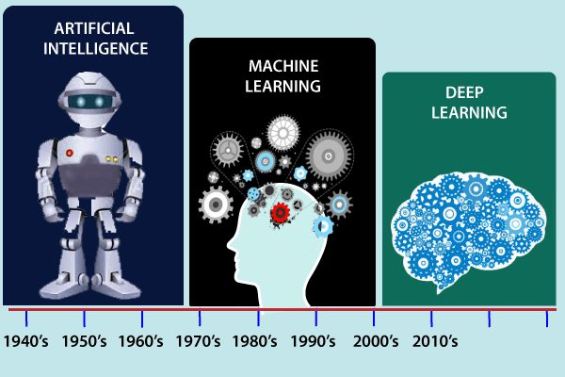
History of Machine Learning
Before some years (about 40-50 years), machine learning was science fiction, but today it is the part of our daily life. Machine learning is making our day to day life easy from self-driving cars to Amazon virtual assistant "Alexa". However, the idea behind machine learning is so old and has a long history. Below some milestones are given which have occurred in the history of machine learning:

Slide 13
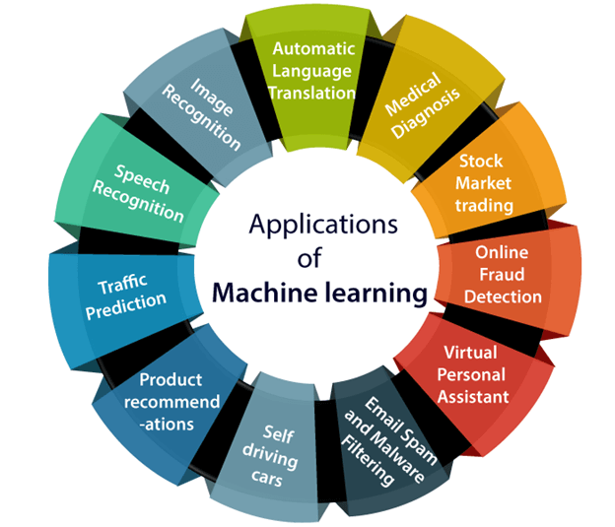
Applications of Machine learning
Machine learning is a buzzword for today's technology, and it is growing very rapidly day by day. We are using machine learning in our daily life even without knowing it such as Google Maps, Google assistant, Alexa, etc. Below are some most trending real-world applications of Machine Learning:

Slide 14
Applications of Machine learning
1. Image Recognition:
Image recognition is one of the most common applications of machine learning. It is used to identify objects, persons, places, digital images, etc. The popular use case of image recognition and face detection is, Automatic friend tagging suggestion:
Facebook provides us a feature of auto friend tagging suggestion. Whenever we upload a photo with our Facebook friends, then we automatically get a tagging suggestion with name, and the technology behind this is machine learning's face detection and recognition algorithm.
It is based on the Facebook project named "Deep Face," which is responsible for face recognition and person identification in the picture.
2. Speech Recognition
While using Google, we get an option of "Search by voice," it comes under speech recognition, and it's a popular application of machine learning.
Speech recognition is a process of converting voice instructions into text, and it is also known as "Speech to text", or "Computer speech recognition." At present, machine learning algorithms are widely used by various applications of speech recognition. Google assistant, Siri, Cortana, and Alexa are using speech recognition technology to follow the voice instructions.
3. Traffic prediction:
If we want to visit a new place, we take help of Google Maps, which shows us the correct path with the shortest route and predicts the traffic conditions.
It predicts the traffic conditions such as whether traffic is cleared, slow-moving, or heavily congested with the help of two ways:
Real Time location of the vehicle form Google Map app and sensors
Average time has taken on past days at the same time.
Everyone who is using Google Map is helping this app to make it better. It takes information from the user and sends back to its database to improve the performance.
4. Product recommendations:
Machine learning is widely used by various e-commerce and entertainment companies such as Amazon, Netflix, etc., for product recommendation to the user. Whenever we search for some product on Amazon, then we started getting an advertisement for the same product while internet surfing on the same browser and this is because of machine learning.
Google understands the user interest using various machine learning algorithms and suggests the product as per customer interest.
As similar, when we use Netflix, we find some recommendations for entertainment series, movies, etc., and this is also done with the help of machine learning.

Slide 15
Applications of Machine learning
5. Self-driving cars:
One of the most exciting applications of machine learning is self-driving cars. Machine learning plays a significant role in self-driving cars. Tesla, the most popular car manufacturing company is working on self-driving car. It is using unsupervised learning method to train the car models to detect people and objects while driving.
6. Email Spam and Malware Filtering:
Whenever we receive a new email, it is filtered automatically as important, normal, and spam. We always receive an important mail in our inbox with the important symbol and spam emails in our spam box, and the technology behind this is Machine learning. Below are some spam filters used by Gmail:
Content Filter
Header filter
General blacklists filter
Rules-based filters
Permission filters
Some machine learning algorithms such as Multi-Layer Perceptron, Decision tree, and Naïve Bayes classifier are used for email spam filtering and malware detection.
7. Virtual Personal Assistant:
We have various virtual personal assistants such as Google assistant, Alexa, Cortana, Siri. As the name suggests, they help us in finding the information using our voice instruction. These assistants can help us in various ways just by our voice instructions such as Play music, call someone, Open an email, Scheduling an appointment, etc.
These virtual assistants use machine learning algorithms as an important part.
These assistant record our voice instructions, send it over the server on a cloud, and decode it using ML algorithms and act accordingly.
8. Online Fraud Detection:
Machine learning is making our online transaction safe and secure by detecting fraud transaction. Whenever we perform some online transaction, there may be various ways that a fraudulent transaction can take place such as fake accounts, fake ids, and steal money in the middle of a transaction. So to detect this, Feed Forward Neural network helps us by checking whether it is a genuine transaction or a fraud transaction.
For each genuine transaction, the output is converted into some hash values, and these values become the input for the next round. For each genuine transaction, there is a specific pattern which gets change for the fraud transaction hence, it detects it and makes our online transactions more secure.

Slide 16
Applications of Machine learning
9. Stock Market trading:
Machine learning is widely used in stock market trading. In the stock market, there is always a risk of up and downs in shares, so for this machine learning's long short term memory neural network is used for the prediction of stock market trends.
10. Medical Diagnosis:
In medical science, machine learning is used for diseases diagnoses. With this, medical technology is growing very fast and able to build 3D models that can predict the exact position of lesions in the brain.
It helps in finding brain tumors and other brain-related diseases easily.
11. Automatic Language Translation:
Nowadays, if we visit a new place and we are not aware of the language then it is not a problem at all, as for this also machine learning helps us by converting the text into our known languages. Google's GNMT (Google Neural Machine Translation) provide this feature, which is a Neural Machine Learning that translates the text into our familiar language, and it called as automatic translation.
The technology behind the automatic translation is a sequence to sequence learning algorithm, which is used with image recognition and translates the text from one language to another language.

Slide 17
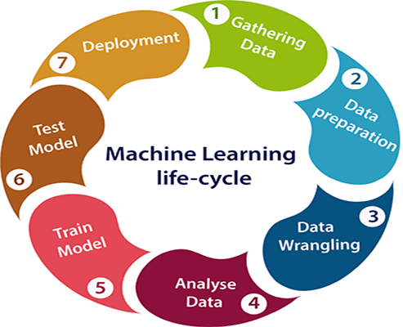
Machine learning Life cycle
Machine learning has given the computer systems the abilities to automatically learn without being explicitly programmed. But how does a machine learning system work? So, it can be described using the life cycle of machine learning. Machine learning life cycle is a cyclic process to build an efficient machine learning project. The main purpose of the life cycle is to find a solution to the problem or project.
Machine learning life cycle involves seven major steps, which are given below:
Gathering Data
Data preparation
Data Wrangling
Analyse Data
Train the model
Test the model
Deployment
The most important thing in the complete process is to understand the problem and to know the purpose of the problem. Therefore, before starting the life cycle, we need to understand the problem because the good result depends on the better understanding of the problem.

Slide 18
Machine learning Life cycle
1. Gathering Data:
Data Gathering is the first step of the machine learning life cycle. The goal of this step is to identify and obtain all data-related problems.
In this step, we need to identify the different data sources, as data can be collected from various sources such as files, database, internet, or mobile devices. It is one of the most important steps of the life cycle. The quantity and quality of the collected data will determine the efficiency of the output. The more will be the data, the more accurate will be the prediction.
This step includes the below tasks:
Identify various data sources
Collect data
Integrate the data obtained from different sources
By performing the above task, we get a coherent set of data, also called as a dataset. It will be used in further steps.

Slide 19
Machine learning Life cycle
2. Data preparation
After collecting the data, we need to prepare it for further steps. Data preparation is a step where we put our data into a suitable place and prepare it to use in our machine learning training.
In this step, first, we put all data together, and then randomize the ordering of data.
This step can be further divided into two processes:
Data exploration: It is used to understand the nature of data that we have to work with. We need to understand the characteristics, format, and quality of data. A better understanding of data leads to an effective outcome. In this, we find Correlations, general trends, and outliers.
Data pre-processing: Now the next step is preprocessing of data for its analysis.

Slide 20
Machine learning Life cycle
3. Data Wrangling
Data wrangling is the process of cleaning and converting raw data into a useable format. It is the process of cleaning the data, selecting the variable to use, and transforming the data in a proper format to make it more suitable for analysis in the next step. It is one of the most important steps of the complete process. Cleaning of data is required to address the quality issues.
It is not necessary that data we have collected is always of our use as some of the data may not be useful. In real-world applications, collected data may have various issues, including:
Missing Values
Duplicate data
Invalid data
Noise
So, we use various filtering techniques to clean the data.
It is mandatory to detect and remove the above issues because it can negatively affect the quality of the outcome.

Slide 21
Machine learning Life cycle
4. Data Analysis
Now the cleaned and prepared data is passed on to the analysis step. This step involves:
Selection of analytical techniques
Building models
Review the result
The aim of this step is to build a machine learning model to analyze the data using various analytical techniques and review the outcome. It starts with the determination of the type of the problems, where we select the machine learning techniques such as Classification, Regression, Cluster analysis, Association, etc. then build the model using prepared data, and evaluate the model.
Hence, in this step, we take the data and use machine learning algorithms to build the model.

Slide 22
Machine learning Life cycle
5. Train Model
Now the next step is to train the model, in this step we train our model to improve its performance for better outcome of the problem.
We use datasets to train the model using various machine learning algorithms. Training a model is required so that it can understand the various patterns, rules, and, features.
6. Test Model
Once our machine learning model has been trained on a given dataset, then we test the model. In this step, we check for the accuracy of our model by providing a test dataset to it.
Testing the model determines the percentage accuracy of the model as per the requirement of project or problem.
7. Deployment
The last step of machine learning life cycle is deployment, where we deploy the model in the real-world system.
If the above-prepared model is producing an accurate result as per our requirement with acceptable speed, then we deploy the model in the real system. But before deploying the project, we will check whether it is improving its performance using available data or not. The deployment phase is similar to making the final report for a project.

Slide 23
Difference between Artificial intelligence and Machine learning
Artificial Intelligence | Machine learning
Artificial intelligence is a technology which enables a machine to simulate human behavior. | Machine learning is a subset of AI which allows a machine to automatically learn from past data without programming explicitly.
The goal of AI is to make a smart computer system like humans to solve complex problems. | The goal of ML is to allow machines to learn from data so that they can give accurate output.
In AI, we make intelligent systems to perform any task like a human. | In ML, we teach machines with data to perform a particular task and give an accurate result.
Machine learning and deep learning are the two main subsets of AI. | Deep learning is a main subset of machine learning.
AI has a very wide range of scope. | Machine learning has a limited scope.
AI is working to create an intelligent system which can perform various complex tasks. | Machine learning is working to create machines that can perform only those specific tasks for which they are trained.
AI system is concerned about maximizing the chances of success. | Machine learning is mainly concerned about accuracy and patterns.
The main applications of AI are Siri, customer support using catboats, Expert System, Online game playing, intelligent humanoid robot, etc. | The main applications of machine learning are Online recommender system, Google search algorithms, Facebook auto friend tagging suggestions, etc.
On the basis of capabilities, AI can be divided into three types, which are, Weak AI, General AI, and Strong AI. | Machine learning can also be divided into mainly three types that are Supervised learning, Unsupervised learning, and Reinforcement learning.
It includes learning, reasoning, and self-correction. | It includes learning and self-correction when introduced with new data.
AI completely deals with Structured, semi-structured, and unstructured data. | Machine learning deals with Structured and semi-structured data.

Slide 24
Supervised Machine Learning
Supervised learning is the types of machine learning in which machines are trained using well "labelled" training data, and on basis of that data, machines predict the output. The labelled data means some input data is already tagged with the correct output.
In supervised learning, the training data provided to the machines work as the supervisor that teaches the machines to predict the output correctly. It applies the same concept as a student learns in the supervision of the teacher.
Supervised learning is a process of providing input data as well as correct output data to the machine learning model. The aim of a supervised learning algorithm is to find a mapping function to map the input variable(x) with the output variable(y).
In the real-world, supervised learning can be used for Risk Assessment, Image classification, Fraud Detection, spam filtering, etc.

Slide 25
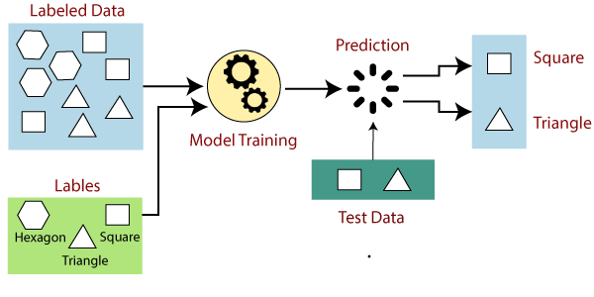
How Supervised Learning Works?
In supervised learning, models are trained using labelled dataset, where the model learns about each type of data. Once the training process is completed, the model is tested on the basis of test data (a subset of the training set), and then it predicts the output.
The working of Supervised learning can be easily understood by the below example and diagram:
Suppose we have a dataset of different types of shapes which includes square, rectangle, triangle, and Polygon. Now the first step is that we need to train the model for each shape.
If the given shape has four sides, and all the sides are equal, then it will be labelled as a Square.
If the given shape has three sides, then it will be labelled as a triangle.
If the given shape has six equal sides then it will be labelled as hexagon.
Now, after training, we test our model using the test set, and the task of the model is to identify the shape.
The machine is already trained on all types of shapes, and when it finds a new shape, it classifies the shape on the bases of a number of sides, and predicts the output.

Slide 26
Steps Involved in Supervised Learning:
First Determine the type of training dataset
Collect/Gather the labelled training data.
Split the training dataset into training dataset, test dataset, and validation dataset.
Determine the input features of the training dataset, which should have enough knowledge so that the model can accurately predict the output.
Determine the suitable algorithm for the model, such as support vector machine, decision tree, etc.
Execute the algorithm on the training dataset. Sometimes we need validation sets as the control parameters, which are the subset of training datasets.
Evaluate the accuracy of the model by providing the test set. If the model predicts the correct output, which means our model is accurate.

Slide 27
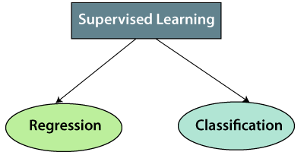
Types of supervised Machine learning Algorithms:
Supervised learning can be further divided into two types of problems:
1. Regression
Regression algorithms are used if there is a relationship between the input variable and the output variable. It is used for the prediction of continuous variables, such as Weather forecasting, Market Trends, etc. Below are some popular Regression algorithms which come under supervised learning:
Linear Regression
Regression Trees
Non-Linear Regression
Bayesian Linear Regression
Polynomial Regression
2. Classification
Classification algorithms are used when the output variable is categorical, which means there are two classes such as Yes-No, Male-Female, True-false, etc.
Spam Filtering,
Random Forest
Decision Trees
Logistic Regression
Support vector Machines

Slide 28
Advantages of Supervised learning:
Disadvantages of supervised learning:
With the help of supervised learning, the model can predict the output on the basis of prior experiences.
In supervised learning, we can have an exact idea about the classes of objects.
Supervised learning model helps us to solve various real-world problems such as fraud detection, spam filtering, etc.
Supervised learning models are not suitable for handling the complex tasks.
Supervised learning cannot predict the correct output if the test data is different from the training dataset.
Training required lots of computation times.
In supervised learning, we need enough knowledge about the classes of object.

Slide 29
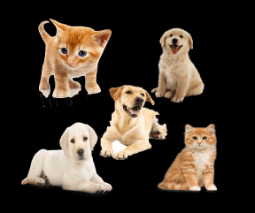
Unsupervised Machine Learning
In the previous topic, we learned supervised machine learning in which models are trained using labeled data under the supervision of training data. But there may be many cases in which we do not have labeled data and need to find the hidden patterns from the given dataset. So, to solve such types of cases in machine learning, we need unsupervised learning techniques.
What is Unsupervised Learning?
As the name suggests, unsupervised learning is a machine learning technique in which models are not supervised using training dataset. Instead, models itself find the hidden patterns and insights from the given data. It can be compared to learning which takes place in the human brain while learning new things. It can be defined as:
Unsupervised learning is a type of machine learning in which models are trained using unlabeled dataset and are allowed to act on that data without any supervision.
Unsupervised learning cannot be directly applied to a regression or classification problem because unlike supervised learning, we have the input data but no corresponding output data. The goal of unsupervised learning is to find the underlying structure of dataset, group that data according to similarities, and represent that dataset in a compressed format.
Example: Suppose the unsupervised learning algorithm is given an input dataset containing images of different types of cats and dogs. The algorithm is never trained upon the given dataset, which means it does not have any idea about the features of the dataset. The task of the unsupervised learning algorithm is to identify the image features on their own. Unsupervised learning algorithm will perform this task by clustering the image dataset into the groups according to similarities between images.

Slide 30
Why use Unsupervised Learning?
Below are some main reasons which describe the importance of Unsupervised Learning:
Unsupervised learning is helpful for finding useful insights from the data.
Unsupervised learning is much similar as a human learns to think by their own experiences, which makes it closer to the real AI.
Unsupervised learning works on unlabeled and uncategorized data which make unsupervised learning more important.
In real-world, we do not always have input data with the corresponding output so to solve such cases, we need unsupervised learning.
Example:
10000 images of person wearing masks.
10000 images of person not wearing masks.
It will categorize the data in 0 and 1 format based on person wearing a mask or not

Slide 31
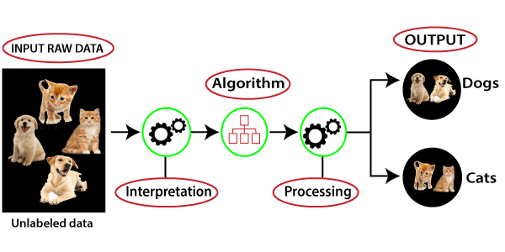
Working of Unsupervised Learning
Working of unsupervised learning can be understood by the below diagram:
Here, we have taken an unlabeled input data, which means it is not categorized and corresponding outputs are also not given. Now, this unlabeled input data is fed to the machine learning model in order to train it. Firstly, it will interpret the raw data to find the hidden patterns from the data and then will apply suitable algorithms such as k-means clustering, Decision tree, etc.
Once it applies the suitable algorithm, the algorithm divides the data objects into groups according to the similarities and difference between the objects.

Slide 32
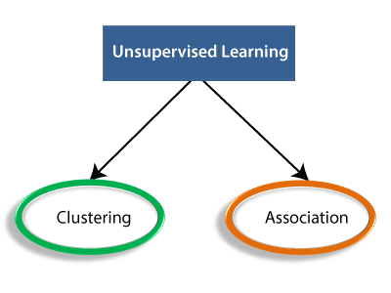
Types of Unsupervised Learning Algorithm:
The unsupervised learning algorithm can be further categorized into two types of problems:
Clustering: Clustering is a method of grouping the objects into clusters such that objects with most similarities remains into a group and has less or no similarities with the objects of another group. Cluster analysis finds the commonalities between the data objects and categorizes them as per the presence and absence of those commonalities.
Association: An association rule is an unsupervised learning method which is used for finding the relationships between variables in the large database. It determines the set of items that occurs together in the dataset. Association rule makes marketing strategy more effective. Such as people who buy X item (suppose a bread) are also tend to purchase Y (Butter/Jam) item. A typical example of Association rule is Market Basket Analysis.

Slide 33
Unsupervised Learning algorithms:
Below is the list of some popular unsupervised learning algorithms:
K-means clustering
KNN (k-nearest neighbors)
Hierarchal clustering
Anomaly detection
Neural Networks
Principle Component Analysis
Independent Component Analysis
Apriori algorithm
Singular value decomposition

Slide 34
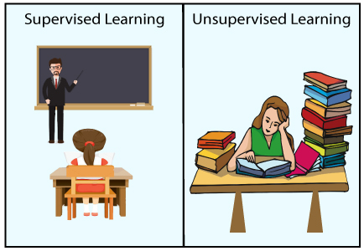
Advantages of Unsupervised learning:
Disadvantages of Unsupervised learning:
Unsupervised learning is used for more complex tasks as compared to supervised learning because, in unsupervised learning, we don't have labeled input data.
Unsupervised learning is preferable as it is easy to get unlabeled data in comparison to labeled data.
Unsupervised learning is intrinsically more difficult than supervised learning as it does not have corresponding output.
The result of the unsupervised learning algorithm might be less accurate as input data is not labeled, and algorithms do not know the exact output in advance.

Slide 35
Difference between Supervised and Unsupervised Learning
Supervised Learning | Unsupervised Learning
Supervised learning algorithms are trained using labeled data. | Unsupervised learning algorithms are trained using unlabeled data.
Supervised learning model takes direct feedback to check if it is predicting correct output or not. | Unsupervised learning model does not take any feedback.
Supervised learning model predicts the output. | Unsupervised learning model finds the hidden patterns in data.
In supervised learning, input data is provided to the model along with the output. | In unsupervised learning, only input data is provided to the model.
The goal of supervised learning is to train the model so that it can predict the output when it is given new data. | The goal of unsupervised learning is to find the hidden patterns and useful insights from the unknown dataset.
Supervised learning needs supervision to train the model. | Unsupervised learning does not need any supervision to train the model.
Supervised learning can be categorized in Classification and Regression problems. | Unsupervised Learning can be classified in Clustering and Associations problems.
Supervised learning can be used for those cases where we know the input as well as corresponding outputs. | Unsupervised learning can be used for those cases where we have only input data and no corresponding output data.
Supervised learning model produces an accurate result. | Unsupervised learning model may give less accurate result as compared to supervised learning.
Supervised learning is not close to true Artificial intelligence as in this, we first train the model for each data, and then only it can predict the correct output. | Unsupervised learning is more close to the true Artificial Intelligence as it learns similarly as a child learns daily routine things by his experiences.
It includes various algorithms such as Linear Regression, Logistic Regression, Support Vector Machine, Multi-class Classification, Decision tree, Bayesian Logic, etc. | It includes various algorithms such as Clustering, KNN, and Apriori algorithm.

